Slide 1


20th Maccabiah - Cycling
Technical Meeting
Friday, July 7, 2017

Slide 2
Agenda
Roll Call, presentation of officials
Greetings from Israel Cycling Federation
Time Table
Safety Aspects
Logistical Aspects
Sporting Aspects
Questions
Distribution of Identification Numbers and Transponders

Slide 3
The Israel Cycling Federation Welcomes the cyclists of the 20th Maccabiah!

Slide 4
Time Table
Sunday July 9 – 6:30 – 12:00 - Time Trial – Cycling Museum Herev Leet
Monday July 10 – 7:00 – 9:00 – Training Ride – Olga
Tuesday July 11 – 14:00-22:00 – Tel Aviv Bike Tour
Friday July 14 – 7:00-11:00 – Road Race – Modiin Bike Park

Slide 5
Safety

Slide 6
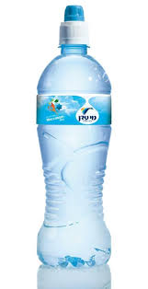
Drink Water!

Slide 7
Traffic
Roads closed to traffic, But,
Police, army, farmers, local citizens’ vehicles may be present
Ride on right-hand side only and watch out for dangers!

Slide 8
Time Trial Safety Concerns
Crossing road between Cycling Museum and Start/Finish – the road is open to traffic!
Riders riding out-and-back – ride on the right hand side only!
2 U-Turns on course

Slide 9
Road Race Safety concerns
Narrow, technical and fast Descent in Canada Ayalon Park
Mountain bikers/ATV’s in Ayalon Canada Park
Driveways, pedestrians, junctions, poor asphalt within Modiin
Out-and-back section on road no. 3 separated by cones
poor asphalt on descent before entrance to Modiin

Slide 10
Logistics

Slide 11
Numbers
Numbers
  Time trial: 1 number on lower back (center).
  Road race: 2 back numbers (right and left) on lower back (on jersey pockets) and 1 frame number

Slide 12
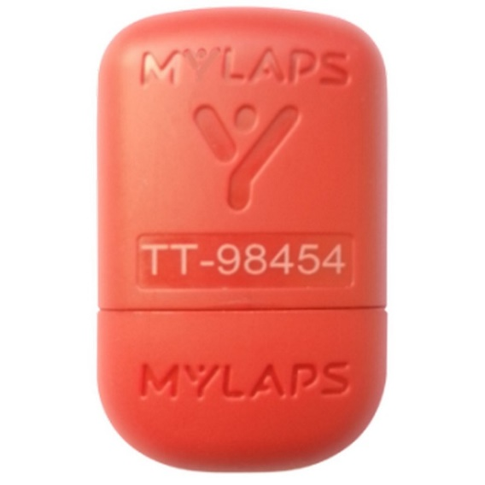
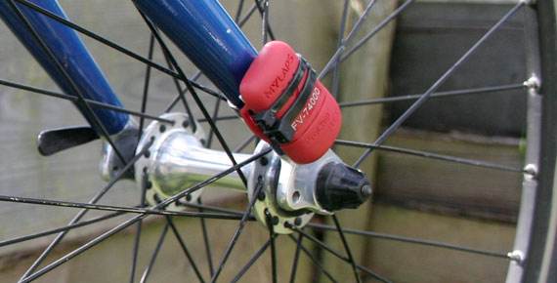
Transponder
Transponder
  Mounted on front fork
  Vertically
  Lost transponder = 200 Shekel replacement fee

Slide 13
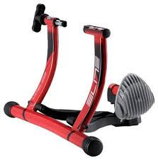
Time Trial – Warm Up
10 trainers near start area for foreign teams, 8 riders = 1 trainer

Slide 14
Lunch provided at venues
10 minute walk/ride from venue to start/finish
Medals Ceremony at 11:40 at cycling museum

Slide 15
Sporting Aspects

Slide 16
Categories and Numbers
Separate number series and color for each category:
Background color | Number Series | Age Group
White | 1-30 | Men 19-29
Blue | 81-99 | Men 17-18
Green | 300 + | Men 30+
Yellow | 400 + | Men 40+
Grey | 500 + | Men 50+
Brown | 600 + | Men 60+
Pink | 101-120 | Women 17-29
Green | 300 + | Women 30-49
Grey | 500 + | Women 50+

Slide 17
Time Trial Course
Venue: Cycling Museum, Herev Leet
Course: 21 km

Slide 18
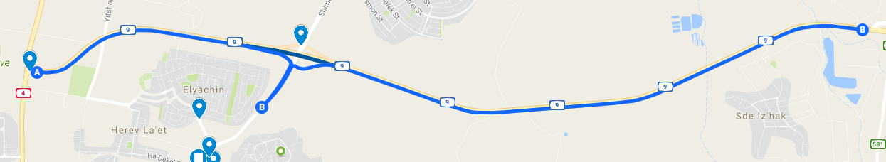
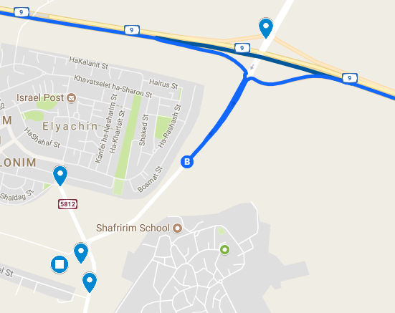
Start/Finish
Cycling Museum, Herev Leet

Slide 19
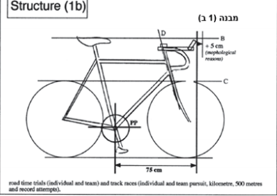
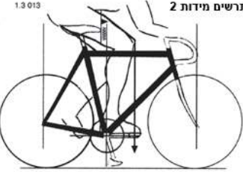
Time trial regulations
Time trial bikes – must be UCI legal to win a medal. Result counts toward Maccabiman competition and team competition anyway.

Slide 20
TT Regulations Enforced 1
Seat position – no less than 5 centimeters behind bottom bracket axis
Aerobar extension – maximum 75 centimeters from bottom bracket axis to furthest extension
Morphological exemptions
  5 cm tolerance wither in seat position or in handlebar position, but not in both
  Additional 5 cm tolerance for riders over 1.90 meters tall
No sunken wheels

Slide 21
TT Regulations Enforced 2
Frame and handlebar profiles:
  Respect the 3:1 ratio
No aerodynamic protectors, fuselage parts, or streamlining additions
Water bottles:
  No handlebar bottles, no rear-of-seat bottles
  Bottles only within main frame triangle
  Min 4 cm. max 10 cm. cross section, 400-800 ml

Slide 22
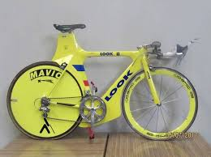
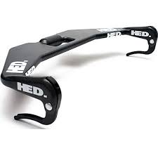
TT Regulations in pictures

Slide 23
Time Trial
Technical support
  Before start: Trek neutral tech station near warm-up area
  During race: neutral vehicle on route
No drafting allowed!
No feeding allowed during time trial

Slide 24
Time Trial
Team Competition
Accumulated time of the fastest rider from each country in four of the following six categories
  Men 17-18
  Men 19+
  Men 30+
  Men 40+
  Men 50+
  Men 60+
  For countries represented in 5 or 6 categories, only the fastest 4 will count
Bicycle must be UCI compliant for rider’s result to count for the team competition

Slide 25
Road Race Course
Venue: Modiin Bike Park
Lap Distance 21 km

Slide 26
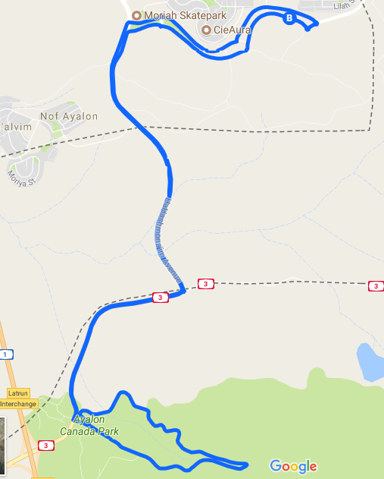

Slide 27
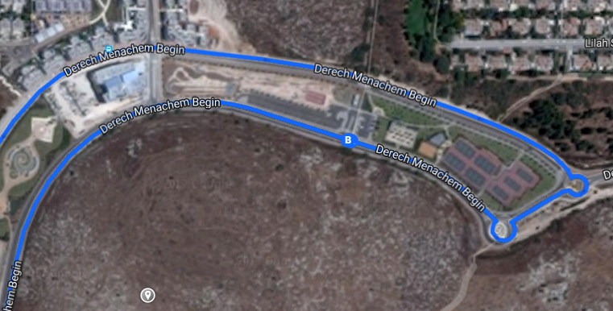
Start / Finish and Venue

Slide 28
Road Race
3 pelotons starting at 2 minute intervals:
  7:00 Men Elite 19+ and 17-18 5 laps
  7:02 Men 30-39, 40-49, 50+ 4 laps
  7:04 Women 17-29, Women 30-49, Women 50+, Men 60+ 3 laps
Same race distance = same peloton
Drafting allowed only between riders racing the same distance

Slide 29
Road Race
Technical support:
  Before start: Israel Cycling Academy
  During race: from neutral support vehicles, or stationary support from delegation, excluding park
Stationary Feeding allowed in feeding zone
Neutral Start on first lap until exit from Modiin
Medal Ceremony after last rider finishes

Slide 30
Road Race
Team Competition
Accumulated time of best rider from each country in each of the following categories
  Men 30+
  Men 40+
  Men 50+

Slide 31
General Notices

Slide 32
TLV Bike Tour
Tuesday July 11 14:00-22:00
Transportation from Hotel
Olympic Experience Museum
Guided Bike Ride
Dinner and free time at TLV Port

Slide 33
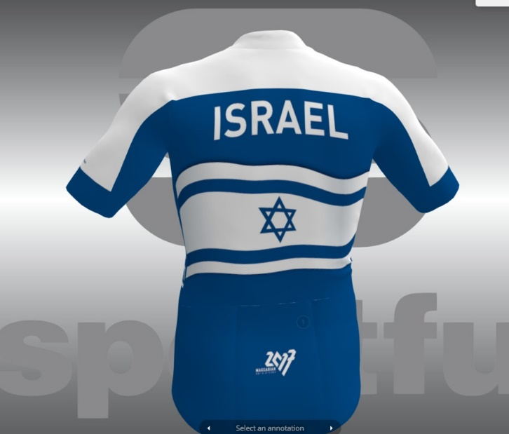
Israel National Team Kit
Official M20 and Israel National Team Cycling Kits for sale at races

Slide 34
Contact info: Yarden Gazit, yarden@israelcycling.org.il
+972 (0)54 7542654

Slide 35
Good Luck!

